Slide 1
IOT projekt Alarm Clock
Rikke Pedersen

Slide 2
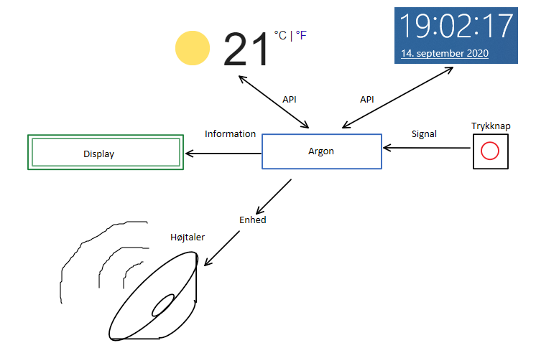

Slide 3
Requirements
When button1 is pressed, the display shall light up
When button1 is pressed, while the display is lit, the display shall change between 2 modes
While the system is on standby, the display shall show the current time and date
When the time is 6:30, the system shall receive new weather information and update display
When button 2 is pressed, an option to set alarm shall appear
When the alarm is triggered, music shall play

Slide 4
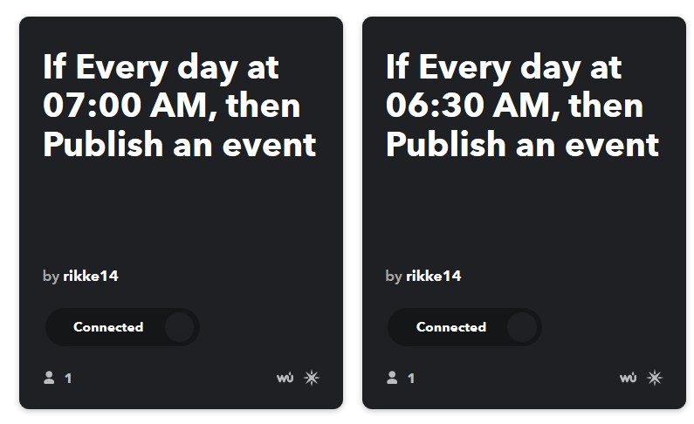
API
IFTTT
Weather Underground
Weather condition
Maximum temperature

Slide 5
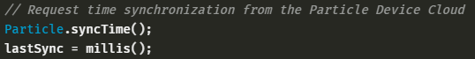
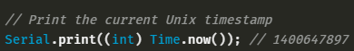
Time

Slide 6
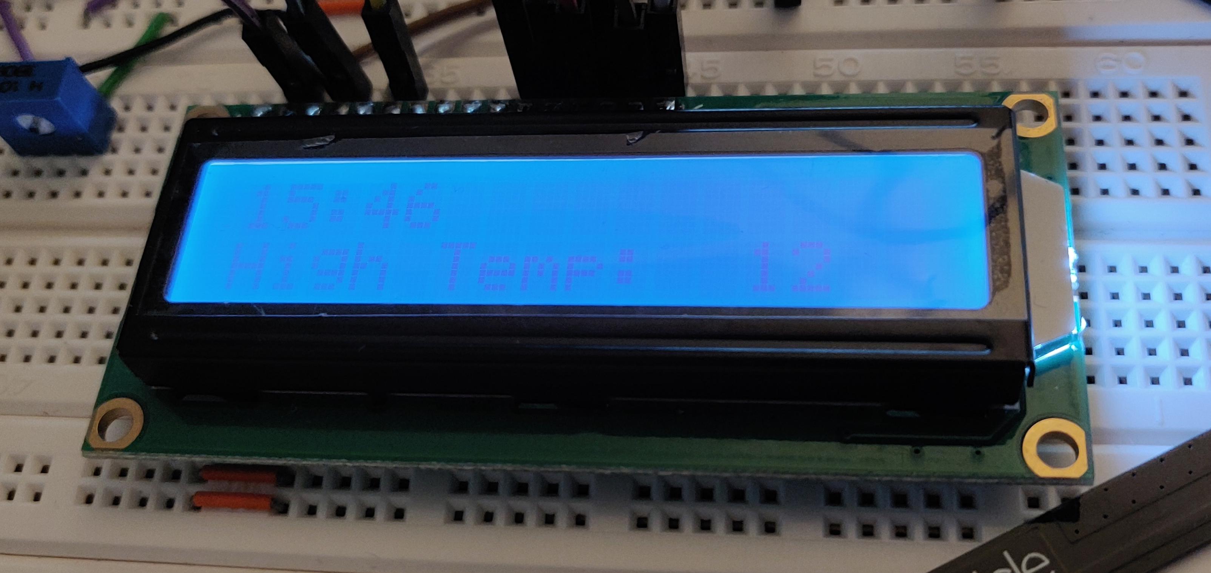
A good result

Slide 7
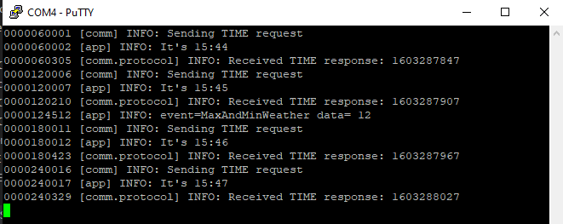
PuTTY

Slide 8
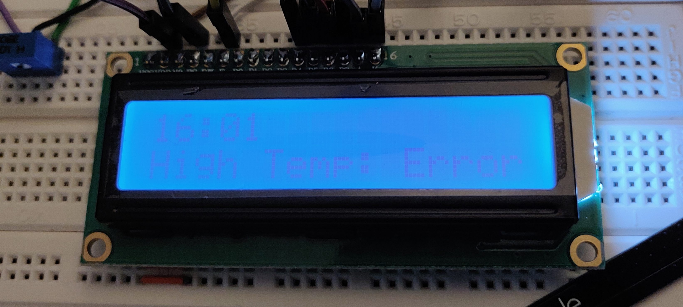
Less fortunate result

Slide 9
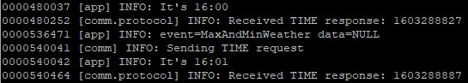
PuTTY

Slide 10
Speaker
I’m still missing the amplifier
Worst case: Buzzer

Slide 11
Alarm
When the API works, this will be the priority

